Slide 1

Time Series and It’s Components
Presented By: Purva Kolhe(226518)
Darshan Gunjal(226506)

Slide 2
INTRODUCTION
We know that planning about future is very necessary for the every business firm, every govt. institute, every individual and for every country. Every family is also doing planning for his income expenditure. As like every business is doing planning for possibilities of its financial resources & sales and for maximization its profit.
A time series consists of a set of observations which are measured at specified (usually equal) time intervals.
Time series analysis attempts to identify those factors that exert an influence on the values in the series. Once these factors are identified, the time series may be used for both short-term and long-term forecasting.

Slide 3
DEFINITION
"A time series is a set of observation taken at " specified times, usually at equal intervals".
"A time series may be defined as a collection of reading belonging to different time periods of some economic or composite variables".
Time series establish relation between "cause" & "Effects".
One variable is "Time" which is independent variable & and the second is "Data" which is the dependent variable.

Slide 4
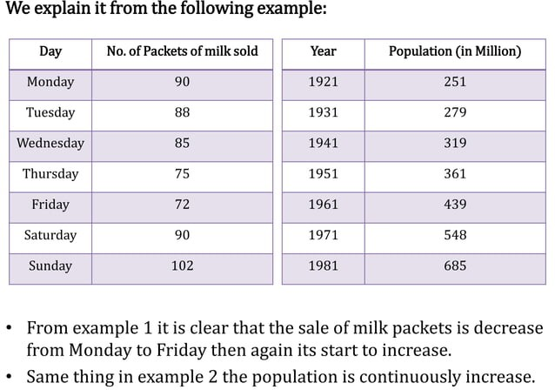

Slide 5
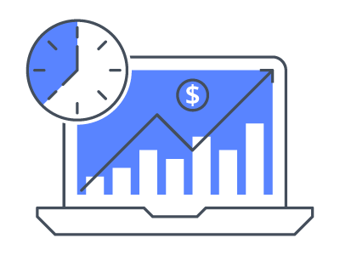
IMPORTANCE OF TIME SERIES ANALYSIS
As the basis of Time series Analysis businessman can predict about the changes in economy. There are following points which clear about the its importance:
Profit of experience.
Safety from future
Utility Studies
Sales Forecasting
Budgetary Analysis
Yield Projections
Stock Market Analysis
Inventory Studies
Economic Forecasting
Risk Analysis & Evaluation of changes.
Census Analysis

Slide 6
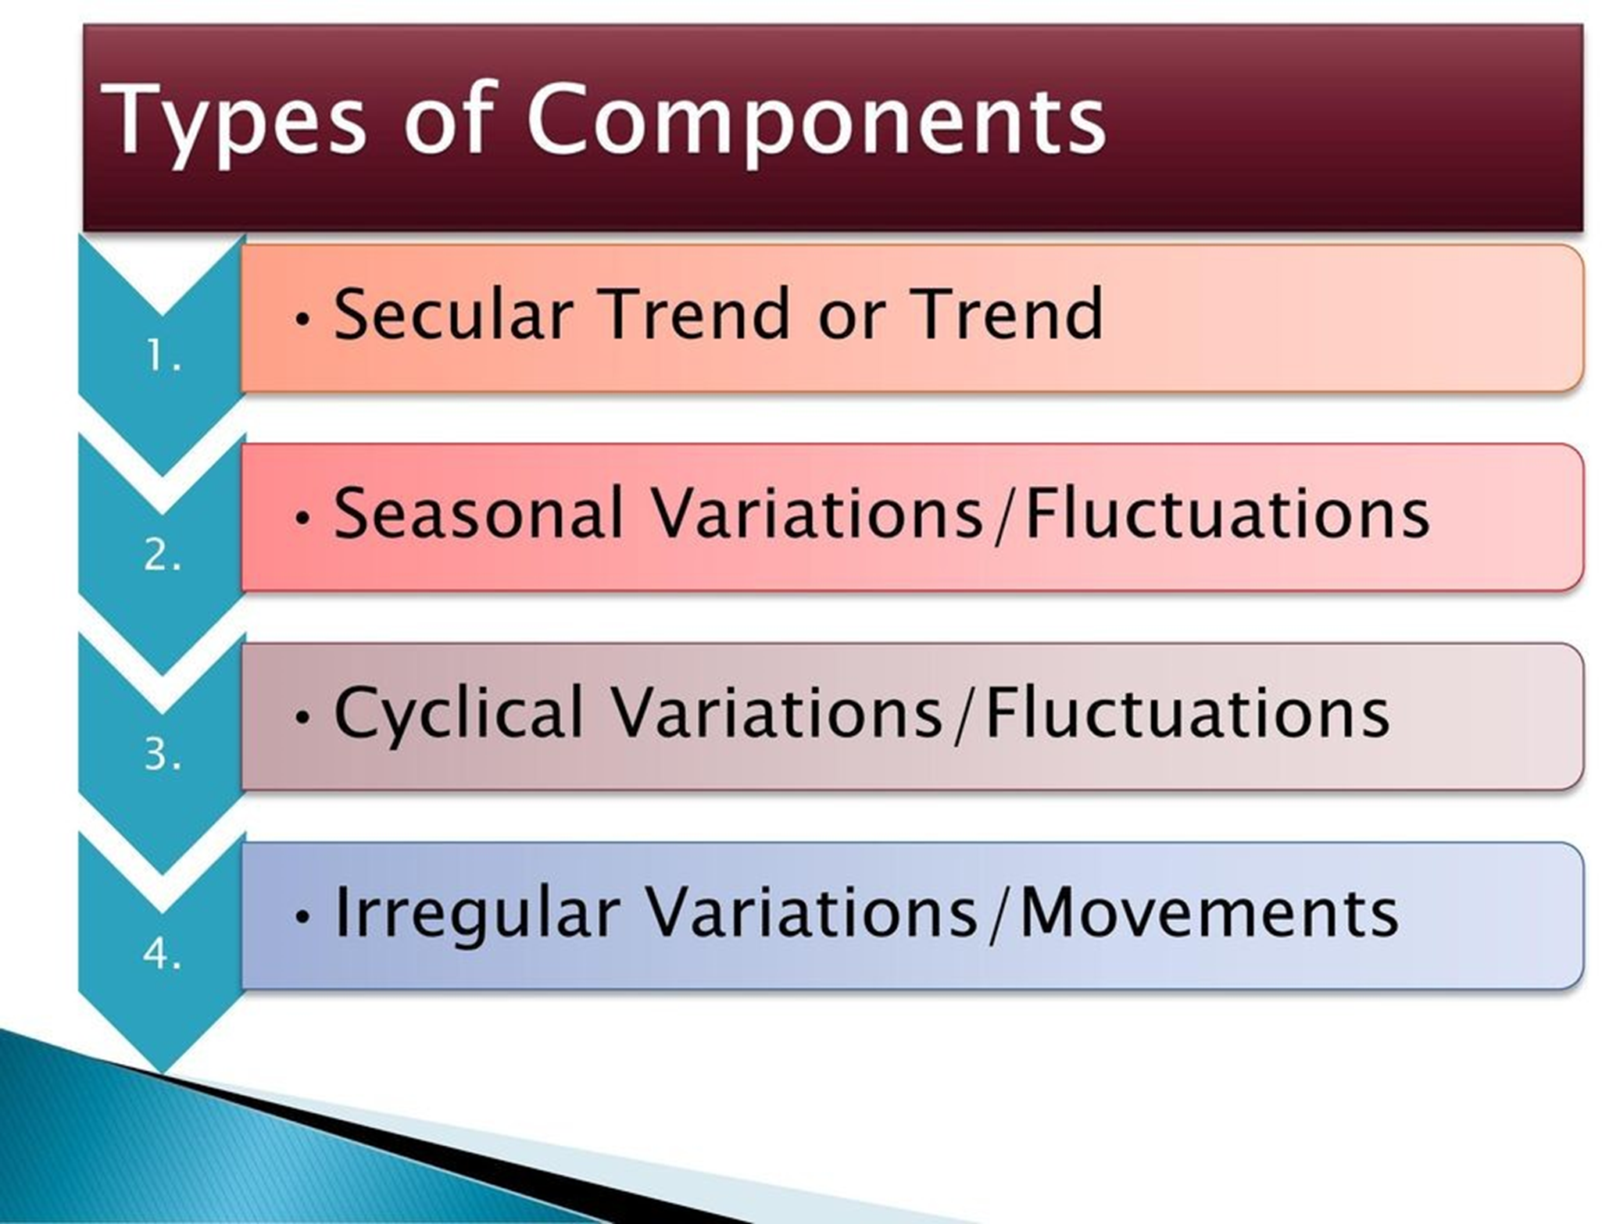

Slide 7
SECULAR TREND OR TREND
The increase or decrease in the movements of a time series is called Secular trend.
A time series data may show upward trend or downward trend for a period of years and this may be due to factors like:
increase in population,
change in technological progress,
large scale shift in consumers demands,
For example:
population increases over a period of time, price increases over a period of years, production of goods on the capital market of the country increases over a period of years. These are the examples of upward trend.
The sales of a commodity may decrease over a period of time because of better products coming to the market. This is an example of declining trend or downward.

Slide 8
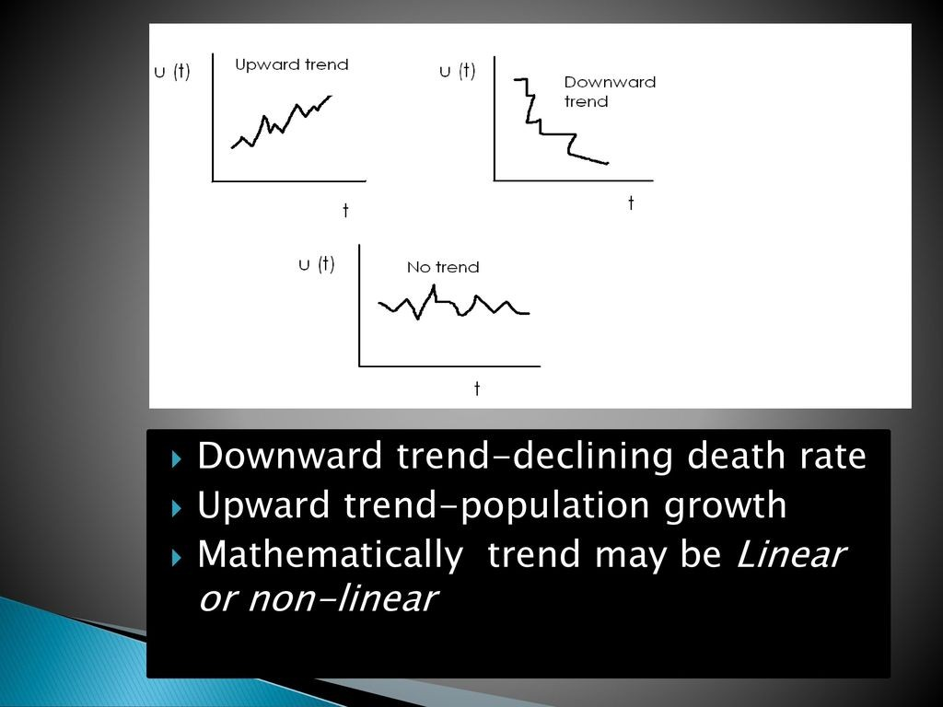

Slide 9
SEASONAL VARIATIONS / FLUCTUATIONS
The component responsible for the regular rise or fall (fluctuations) in the time series during a period not more than 1 year.
Fluctuations occur in regular sequence(periodical)
The period being a year, a month, a week, a day, or even a fraction of the day, an hour etc.
Term "SEASONAL is meant to include any kind of variation which is of periodic nature and whose repeating cycles are of relatively short duration.
The factors that cause seasonal variations are: (a)Climate & weather condition, (b) Customs traditions & habits

Slide 10
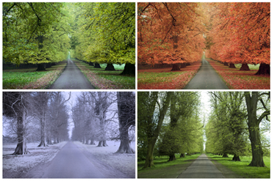
EXAMPLES
Crops are sown and harvested at certain times every year and the demand for the labour growing up during sowing and harvesting seasons.
Demands for woolen clothes goes up in winter
Withdraws from banks are heavy during first week of the month.
The number of letter posted on Saturday is larger.
Train ticket sale increase dramatically during festive Seasons

Slide 11
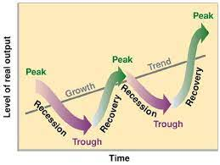
CYCLICAL VARIATIONS
Cyclical variations are recurrent upward or downward movements in a time series but the period of cycle is greater than a year. Also these variations are not regular as seasonal variation.
A business cycle showing these oscillatory movements has to pass through four phases-prosperity, recession, depression and recovery. In a business, these four phases are completed by passing one to another in this order.

Slide 12
EXAMPLES
The opening of a new shopping complex
The building of a new airport
Economics depressions or recessions
Major sporting events, such as the Olympic Games
Changes in consumer spending (i.e. lack of confidence)
Changes in government monetary policy

Slide 13
IRREGULAR VARIATION
Irregular variation in the time series occurs varying (usually short) periods. It follows no regular pattern and is by nature unpredictable. It usually occurs randomly and may be linked to events that also occur randomly.
It cannot be explained mathematically. In general, if the variation in a time series cannot be accounted for by secular trend, or by seasonal or cyclical variation, then it is usually attributed to irregular variation.

Slide 14
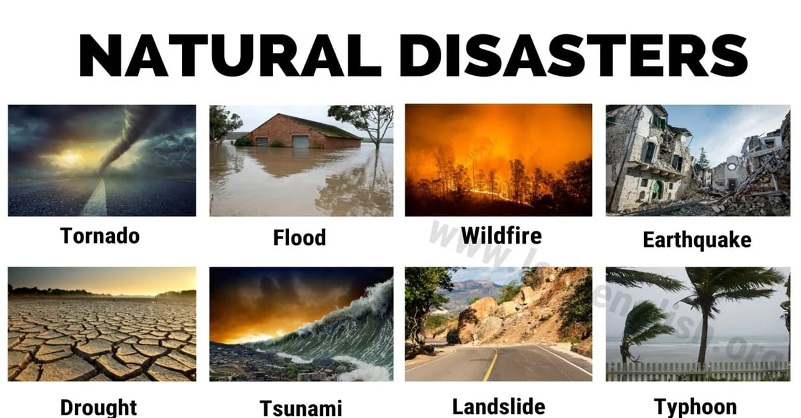
EXAMPLES
Natural disasters
Sudden shifts in government policy
A government calling an unexpected election
Dramatic changes to the stock market
Sudden Changes in interest rates
The effect of war in the Middle East on petrol prices around the world

Slide 15
MATHEMATICAL MODELS OF TIME SERIES
Additive Model:
We assume that the data is the sum of the time series components.
Y_{t} = T_{t} + S_{t} + C_{t} + I_{t}
This model assumes that all four components of the time series act independently of each other.
It is suggested to use when the variability are the same throughout the length of the series.
Multiplicative mode:
We assume that the data is the product of the various components.
Y_{t} = T_{t} x S_{t} x C_{t} x I_{t}
The multiplicative model assumes that the various components in a time series operate proportionately to each other.
It is suggested to use when the variability are the increasing throughout the length of the series.

Slide 16


